Slide 1
FOOTBALL xG Classifier
Presented By – Rahul Daruka
Neel Kamal
Date – April 12th, 2024

Slide 2
1
PROBLEM SETTING
Football aims for scoring goals, making understanding shot success crucial
Expected Goals (xG) quantifies shot-goal probability
This project employs machine learning to predict xG based on multiple features
2
PROBLEM DEFINITION
Develop a predictive model for estimating xG of a shot
Incorporate features like shot distance, angle to goal, and possibly others through feature engineering
Goal: Predict shot conversion probability

Slide 3
DATA COLLECTION
Football event data from Wyscout platform
Covers top five European leagues (England, Spain, Italy, Germany, France)
Publicly available and cited from Luca Pappalardo et al.'s research paper: https://doi.org/10.6084/m9.figshare.c.4415000.v5

Slide 4
DATA DESCRIPTION
12 columns and approximately 600k rows
Focus on shots (eventId=10), comprising 40,461 rows
Key features for xG model:
1- Shot positions (start and end coordinates).
2 - Outcome tags (e.g., goal, miss).
3 - Other pertinent features derived from event data.
Sample variables - shot distance, shot angle, outcome
Datasets offer a wealth of information for feature selection and engineering to construct and assess the xG model.

Slide 5
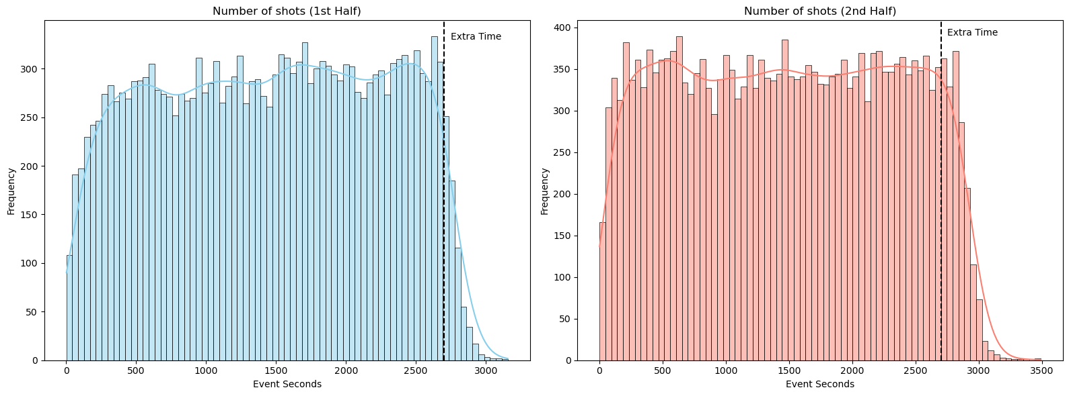
DATA EXPLORATION
1st HALF
2nd HALF
Shot distribution starts with low frequency, peaks in the middle, then gradually decreases
Shot frequency increases notably after approximately 10 minutes and decreases around 35 minutes demonstrating fatigue
Frequency decreases towards the end of the half, with a dip approaching extra time
Similar pattern to the first half but with higher overall frequencies due to tactical changes
Peak frequency lasts longer, roughly from 15 minutes to around 40 minutes due to aggressive play style
Decrease in shots towards the end of the half, particularly before extra time

Slide 6
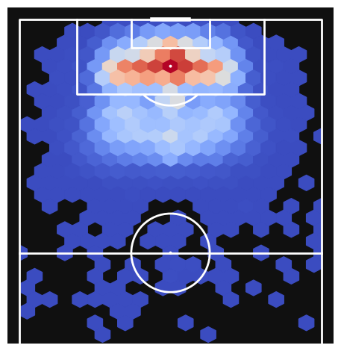
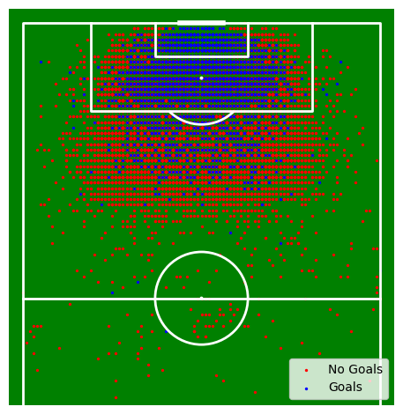
SHOT DENSITY CHART
Higher shot density in the central area near the goal
Gradient heatmap indicates shot frequency, with red representing the highest frequency
Emphasizes the significance of shooting accuracy and concentration near the goal, suggesting a higher likelihood of scoring from these positions
GOAL OR NO GOAL SHOT CHART
Dense concentration of shots observed in the penalty box
Mix of goals (blue) and no goals (red) indicates shot outcomes
Highlights the importance of accuracy and shot concentration in the critical goal-scoring area

Slide 7
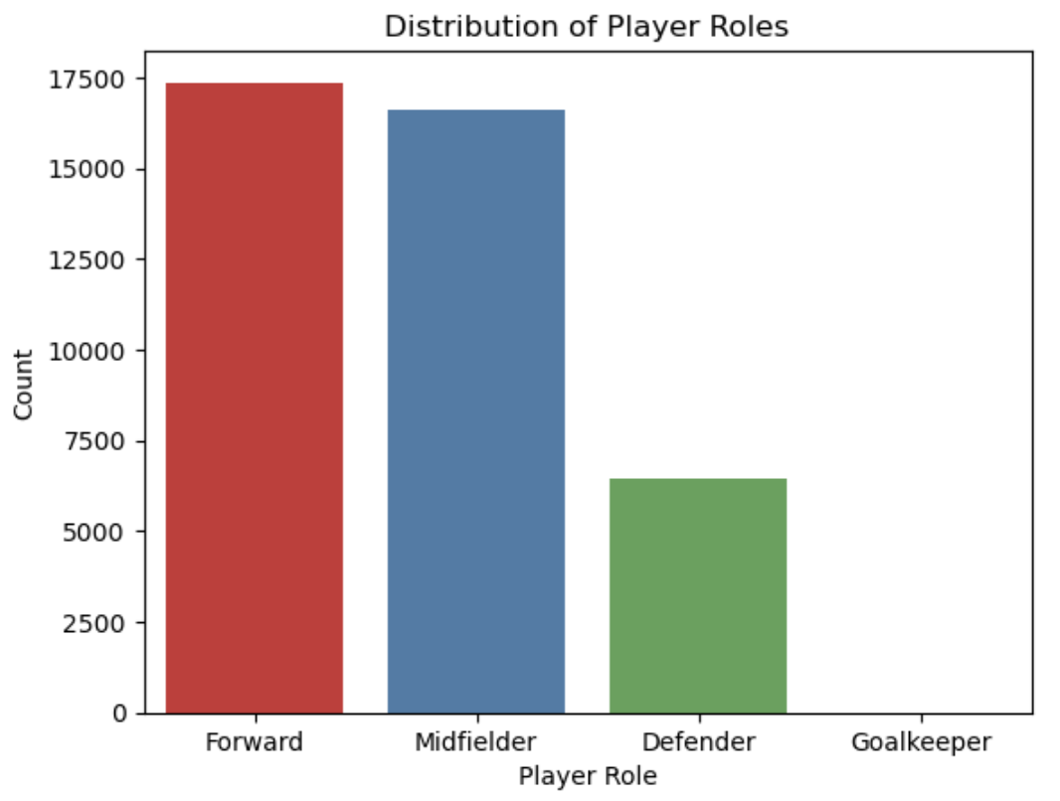
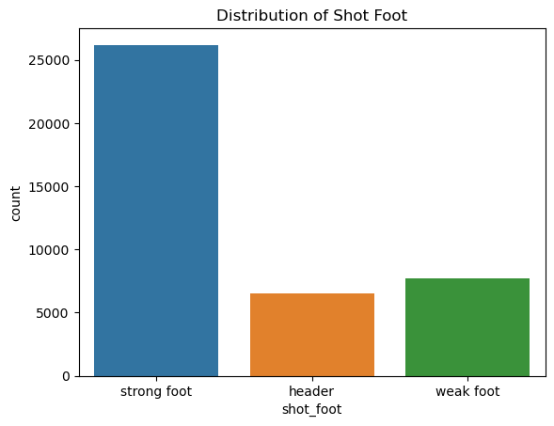
PLAYER ROLES DISTRIBUTION
Forward and Midfielder roles are most common, followed by Defenders, and then Goalkeepers, aligning with typical team formations
Aids in understanding dataset composition and player involvement in events like shots and goals, offering insights into team strategies and player responsibilities
SHOT DISTRIBUTION BY FOOT TYPE
Strong foot shots are predominant, followed by headers and weak foot shots, reflecting player preferences
Valuable for xG model predictions, as strong foot shots may have higher goal probabilities, emphasizing the importance of shot type in goal-scoring likelihood

Slide 8
DATA MINING TASKS – FEATURE ENGINEERING
Extracting X-Y Coordinates:
Transform data to extract precise shot positions using feature extraction techniques, enabling analysis of shot locations.
Feature Extraction from Tags:
Utilize tags in the dataset to identify specific events such as goals, assists, and shots, facilitating the creation of relevant features for model building.
Target Variable Identification:
Designate the shot outcome (goal or no goal) as the target variable for model training and evaluation, essential for predicting shot success.
Body Part Analysis:
Determine the body part used for shots (e.g., right foot, left foot, header) using tags, providing categorical features for model building and insights into player preferences.
Player Dataset Integration:
Merge additional player dataset to gain insights into player characteristics such as preferred foot, facilitating analysis of shot success based on player attributes.

Slide 9
DATA MINING TASKS – DIMENSION REDUCTION
Dimensionality Reduction:
Eliminate redundant or irrelevant columns/features from the dataset to reduce complexity and enhance model performance based on domain knowledge.
Handling Missing Values:
Address missing values in the dataset by dropping rows with null values to ensure data integrity and model accuracy.
Outlier Detection and Removal:
Identify and remove outliers, particularly extreme values in height and weight, to prevent skewing model predictions.
Chi-Squared Test:
Perform statistical analysis to determine the relationship between player foot preference and goal scoring likelihood, providing insights into the significance of player attributes on shot success.
Interpretation of Chi-Squared Test Results:
Evaluate the strength of association between player foot preference and goal scoring likelihood based on chi-squared statistic and p-value, guiding model interpretation and decision-making.

Slide 10
DATA MINING TASKS – PRE MODELLING TASKS
Shot Distance and Angle Calculation:
Shot distance and angle were calculated using standardized coordinates, providing essential spatial information for predicting goal outcomes.
Label Encoder:
Categorical features were converted into numerical formats using label encoding, facilitating model interpretation and learning.
Train-Test Split:
Data was split into training and testing sets (70-30 split) for model evaluation, ensuring robustness and generalization.
Oversampling (SMOTE):
Oversampling was employed to address class imbalance, enhancing the model's ability to detect positive instances and improving overall predictive performance.

Slide 11
DATA MODELS
LOGISTIC REGRESSION
Suitable for binary classification tasks like goal prediction
DECISION TREE
Handles numerical and categorical data, captures non-linear relationships
RANDOM FOREST
Well-suited for mixed data types, robust to overfitting

Slide 12
DATA MODELS
GRADIENT BOOSTING MACHINES
Effective for structured datasets, captures complex relationships
SUPPORT VECTOR MACHINE
Effective for binary classification with appropriate preprocessing.
K-NN
Simple, similarity-based predictions.

Slide 13
MODEL SELECTION
1- Logistic Regression
High accuracy but struggles with recall.
Oversampling improves recall significantly but reduces precision.
Interpretability is a notable advantage of Logistic Regression, making it easier to understand the factors influencing goal outcomes.
2 - Random Forest
High accuracy on imbalanced data but low recall.
Oversampling improves recall but decreases precision and accuracy.
Random Forest's ability to handle mixed data types and its robustness to overfitting make it a strong candidate for the xG model's deployment.
3 - Gradient Boosting
High accuracy on imbalanced data.
Significant increase in recall with oversampling but reduced precision.
Gradient Boosting's iterative improvement on the weaknesses of decision trees and its high predictive accuracy make it a promising choice for the xG model.

Slide 14
MODEL SELECTION
2nd
1st
3th
GRADIENT BOOSTING
RANDOM FOREST
LOGISTIC REGRESSION

Slide 15
MODEL PERFORMENCE
82 %
25 %
ACCURACY
PRECISION
33 %
28 %
RECALL
F1 SCORE
RANDOM FOREST

Slide 16
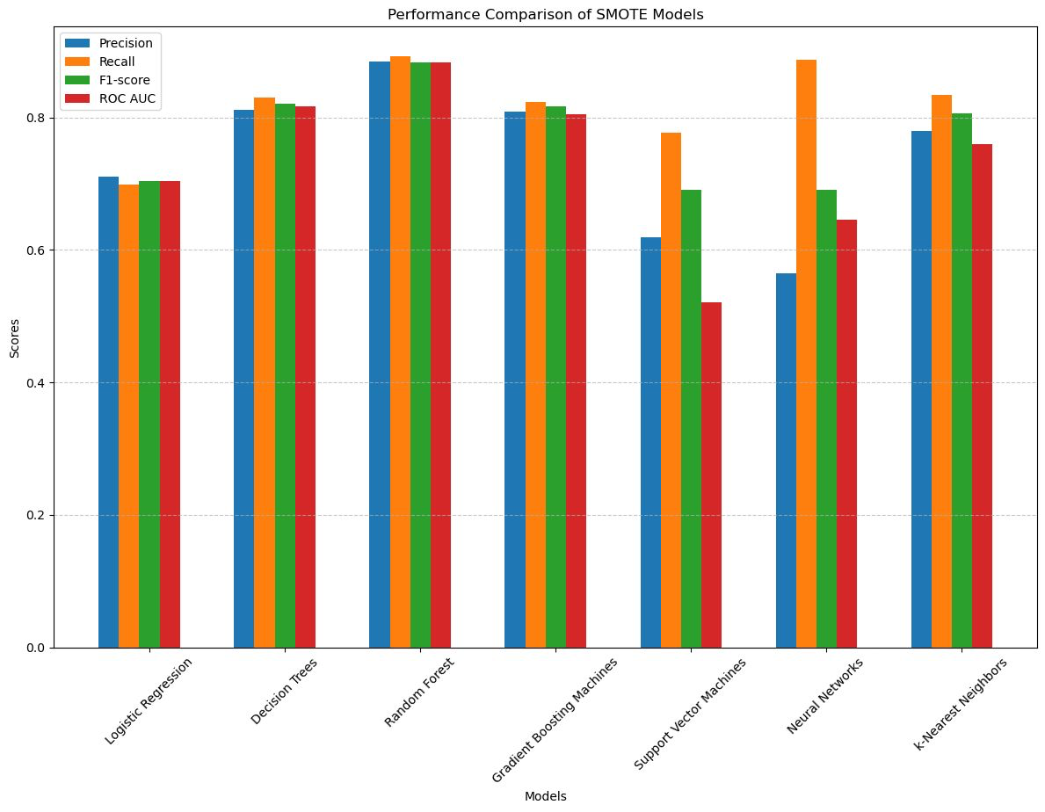
K FOLDS CROSS VALIDATION
Oversampling improves recall but reduces precision
Non-oversampled models tend to be more precise but with low recall.

Slide 17
MODEL SELECTION CONCLUSION
Among the evaluated models, Random Forest and Gradient Boosting stand out due to their high accuracy on imbalanced data.
Oversampling improves recall in all three models but often at the expense of precision.
Logistic Regression is interpretable but may not capture complex interactions effectively.
Random Forest provides a good balance between accuracy and recall, making it a suitable choice for the xG model's deployment. Gradient Boosting also shows promise with its high accuracy and improved recall with oversampling.

Slide 18
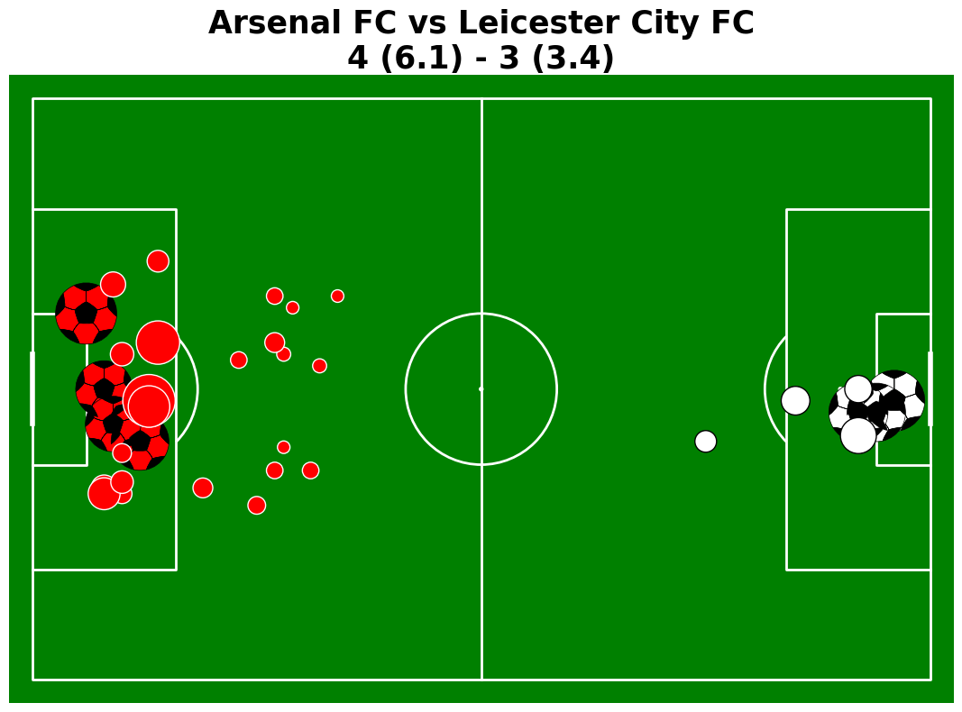
MODEL APPLICATION
- Actual Goal
Actual Goal -
- xG of a Shot
xG of a Shot -

Slide 19
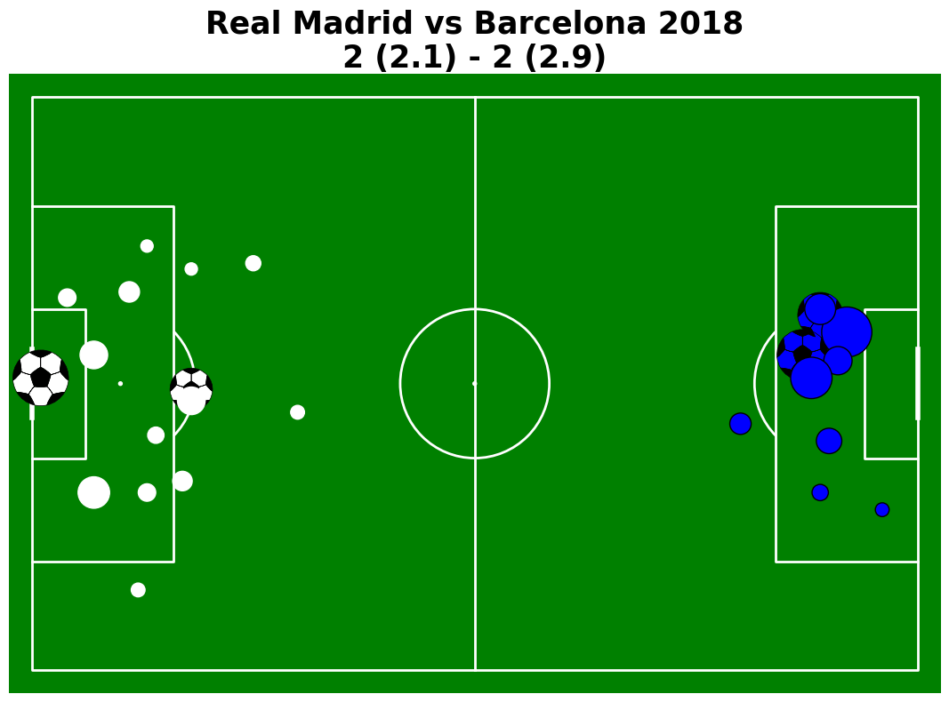
MODEL APPLICATION
- Actual Goal
Actual Goal -
- xG of a Shot
xG of a Shot -

Slide 20
Insights for Decision Making:
Player Performance Analysis:
Key Point: Assess individual player contributions to goal-scoring opportunities.
Impact: Facilitates informed decisions on player selection, contract negotiations, and squad rotations.
Example: Identify top-performing players based on their xG contributions for strategic team planning.
Tactical Adjustments:
Key Point: Analyze shot patterns to inform tactical adjustments during matches.
Impact: Enables coaches to modify formations, positional strategies, and attacking patterns.
Example: Identify opponent weaknesses to exploit during matches for tactical advantage.
Opponent Analysis:
Key Point: Understand opponent xG profiles for effective match preparation.
Impact: Helps devise defensive strategies and capitalize on opponent vulnerabilities.
Example: Analyze opponent shot patterns to develop defensive tactics and counter strategies.
Strategic Planning:
Key Point: Utilize historical xG data for long-term strategic planning.
Impact: Analyze trends, set performance targets, and foster continuous improvement.
Example: Set strategic objectives based on historical xG data for long-term success.

Slide 21
Impact of Project Outcomes:
Performance Enhancement:
Key Point: Enhance team performance through data-driven insights into goal-scoring probabilities.
Impact: Improve performance analysis, strategic planning, and tactical decision-making.
Example: Optimize team performance on the field through enhanced understanding of shot outcomes.
Competitive Advantage:
Key Point: Gain a competitive edge in professional football through predictive analytics.
Impact: Stay ahead of the competition by exploiting opponent weaknesses and maximizing goal-scoring opportunities.
Example: Achieve success on the field by making informed decisions based on predictive modeling insights.
Innovation in Sports Analytics:
Key Point: Contribute to the advancement of sports analytics through innovative approaches.
Impact: Introduce new methods for analyzing football data and pave the way for future research and innovation.
Example: Combine machine learning techniques with traditional performance metrics for groundbreaking insights.
Fan Engagement and Experience:
Key Point: Enhance fan engagement and experience through deeper insights into the game.
Impact: Foster greater interest, discussion, and interaction within the fan community.
Example: Provide fans with visualizations of xG data and match analyses for an enriched viewing experience.

Slide 22
THANK YOU!!

